Slide 1



DATA ANALYSIS
OF COMPUTER SCIENCE FIELDS & CAREER TRENDS

Slide 2

This project explores Computer Science career paths, their salary trends, demand, difficulty, and future growth.
Using a dataset of 5000+ rows, I applied advanced SQL queries to extract insights that help:
Students choose the right learning path
Job seekers understand salary expectations
HR teams know which fields are trending
Tech enthusiasts explore future opportunities
Goal:
To transform raw data into meaningful, actionable insights.
WHY THIS
PROJECT?

Slide 3


DATASET OVERVIEW
The dataset contains ~5000 records, each representing a CS field or track, including:
Main Field & Sub-Track
Average Salary (USD)
Required Skills & Tools
Difficulty Level
Industry Using It
Job Demand Score
Growth Rate
Gender & Age
Learning Duration
Remote-Friendly Score
Country Demand
Sources:
Manually curated & enhanced using SQL + synthetic augmentation.
(My Creation)

Slide 4


PROJECT OVERVIEW
🧠 Why I Chose This Dataset
Computer Science careers are growing rapidly and constantly evolving.
Salaries and demand vary significantly across fields and tracks.
Students, job seekers, and HR teams can benefit from understanding these trends.
Ideal dataset to practice real-world SQL analysis, similar to actual industry tasks.
Combines skills, salary, demand, difficulty, growth, tools & demographics in one dataset.
🎯 Project Objectives
Identify the highest-paying CS fields and tracks.
Analyze job demand, growth rate, and difficulty levels across specializations.
Compare salary differences by gender, remote-friendliness, and age groups.
Evaluate ROI: salary vs. learning time.
Determine which industries and countries offer the best opportunities.
Extract actionable insights for career decisions and talent analysis.

Slide 5


QUESTIONING
To avoid overwhelming the audience with 20 separate insights,
the questions were grouped into three logical sections
MARKET OVERVIEW “THE LANDSCAPE”
FINANCIAL INSIGHTS
“THE PAYOFF”
CAREER STRATEGY
“THE ACTIONABLE TAKEAWAYS”
Focus:
Job demand
Growth rates
Country comparisons
Engagement Goal:
Help the audience understand the current state of the tech industry.
Focus:
Average salaries
Highest & lowest paying fields
Difficulty vs. salary payoff
Engagement Goal:
Answer the most important question:
“How much can I earn?”
Focus:
ROI of learning time
Remote-friendly roles
Tools & industries
Multi-filter career decisions
Engagement Goal:
Give practical, high-value guidance based on the data.

Slide 6
QUESTIONS
1- Which main CS field has the highest average salary?
2- Which CS sub-track has the highest average job demand score?
3- Which country has the highest demand for each CS track?
4- Which age group earns the highest average salary?
5- Which CS fields have the highest growth rate?
6- Which Main Field has the absolute lowest average salary?
7- Which 10 sub-tracks have the highest average salary?
8- Which 10 certifications lead to the highest salaries?
9- Which 10 sub-tracks have the lowest job demand score?
10- Which track requires the maximum average learning time (in months)?
11- Which sub-track provides the highest salary return per month of learning?
12- What is the average salary difference between High Difficulty and Low Difficulty tracks?
13- What is the most significant gender salary gap across all Main Field categories?
14- Does gender impact average salary in CS tracks (Overall)?
15- Do remote-friendly tracks pay more?
16- Which CS fields are the hardest AND highest-paid?
17- Which industry pays the highest salary for the most demanded main field?
18- Which 5 tracks are the MOST remote-friendly based on high salary AND job demand?
19- What are the top 5 highest-paying tracks that require LESS than 12 months of learning?
20- Which tools are used in the TOP 5 highest-paying individual records (not aggregated)?

Slide 7
Let’s Start Answering Some Questions!

Slide 8
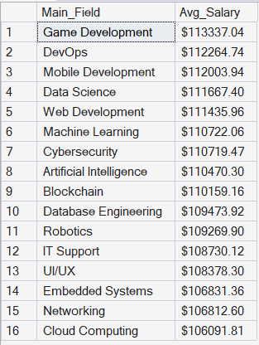
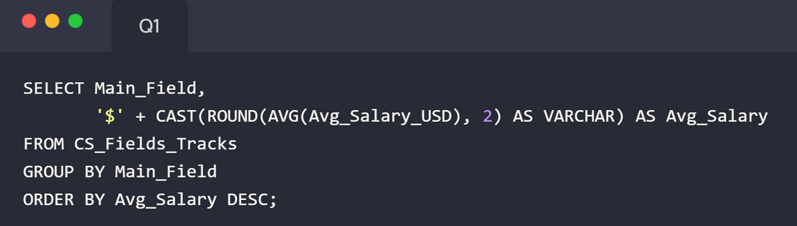

Q1: TOP FINANCIAL CEILING (HIGHEST SALARY)
Which main CS field has the highest average salary?
To identify the absolute highest financial ceiling in the field.

Slide 9
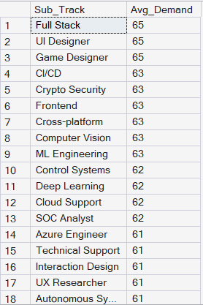
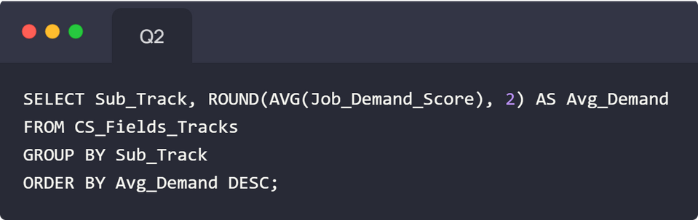
Q2: GREATEST MARKET OPPORTUNITY (JOB DEMAND)
Which CS sub-track has the highest average job demand score?
To reveal where the market has the most immediate need for talent.

Slide 10
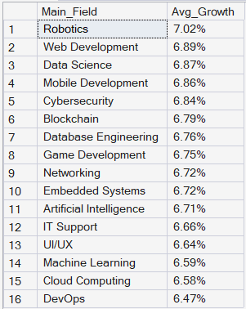
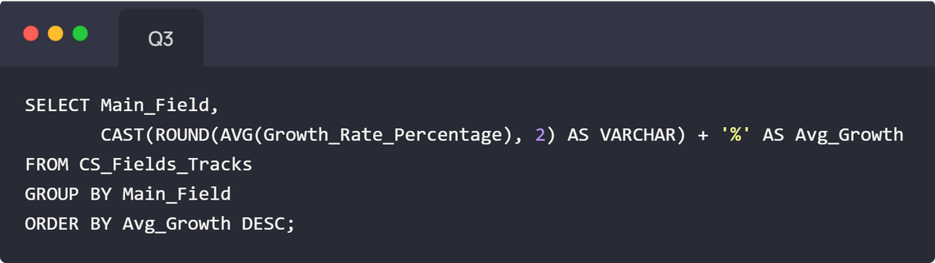
Q3: LONG-TERM STABILITY (GROWTH RATE)
Which CS fields have the highest growth rate?
To identify fields that offer the best long-term stability and future relevance.

Slide 11
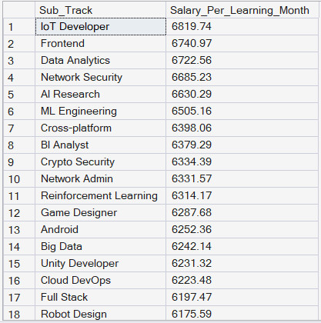
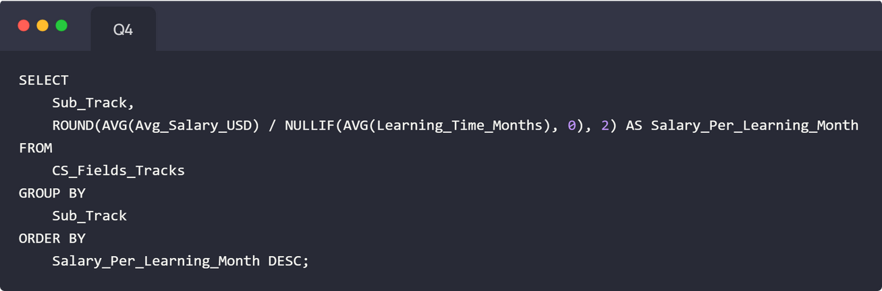
Q4: THE MOST EFFICIENT CAREER PATH (ROI)
Which sub-track provides the highest salary return per month of learning (ROI)?
To quantify the most efficient path (biggest payoff for least learning time).

Slide 12
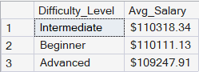
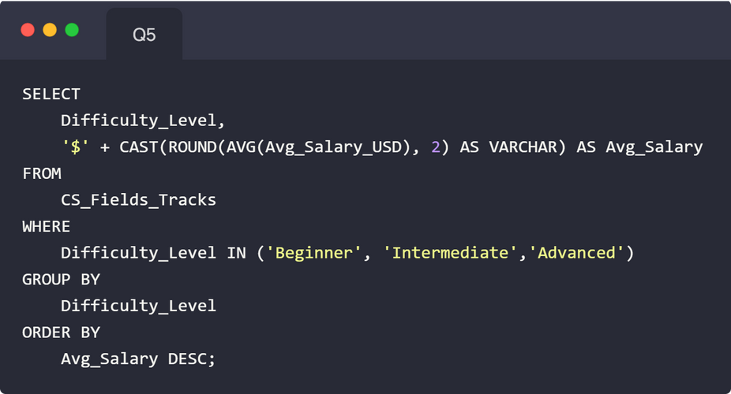
Q5: RISK VS. REWARD (DIFFICULTY VS. PAY)
What is the average salary difference between High Difficulty and Low Difficulty tracks?
To justify the financial reward for pursuing harder, riskier tracks.

Slide 13
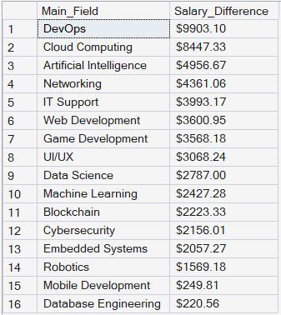
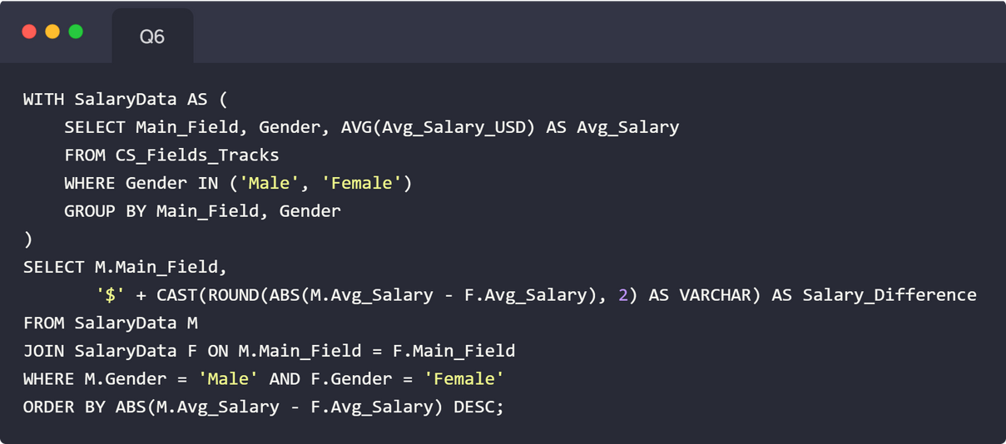
Q6: CRITICAL SOCIAL INSIGHT (GENDER GAP)
What is the most significant gender salary gap across all Main Field categories?
To highlight a critical equity issue and drive organizational focus.

Slide 14
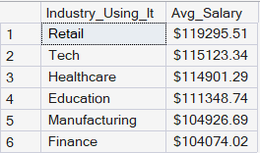
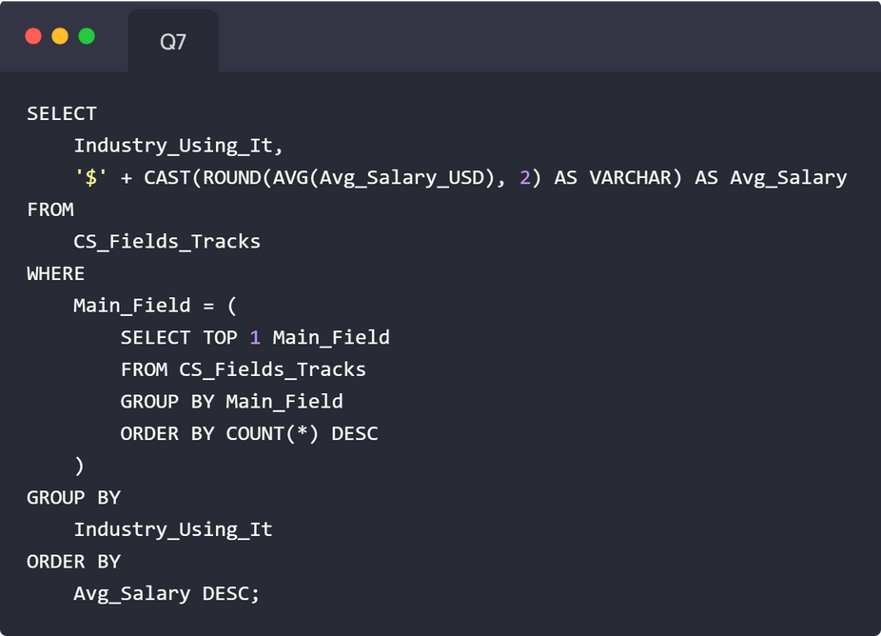
Q7: THE LUCRATIVE TARGET (INDUSTRY PAY)
Which industry pays the highest salary for the most demanded main field?
To give the audience a specific, highly lucrative industry to target within a demanded field.

Slide 15
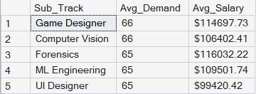
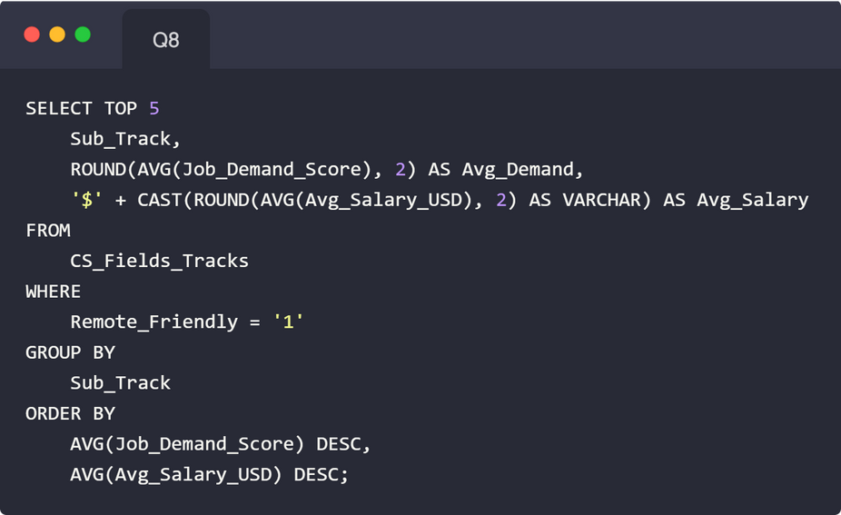
Q8: LOCATION INDEPENDENCE (REMOTE WORK)
Which 5 tracks are the MOST remote-friendly based on high salary AND job demand?
To identify the best fields for location independence combined with high pay.

Slide 16
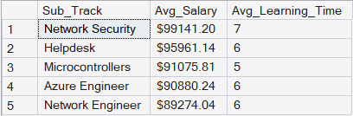
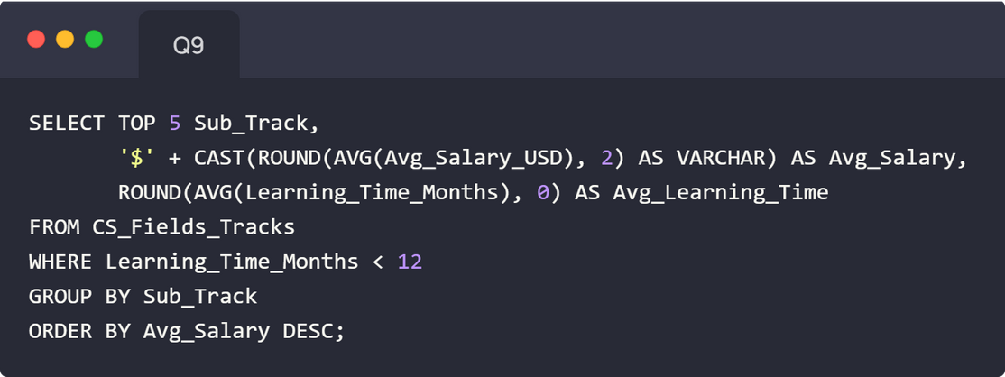
Q9: QUICKEST CAREER WINS (LOW BARRIER)
What are the top 5 highest-paying tracks that require LESS than 12 months of learning?
To provide quick-win strategies for career changers who need fast results.

Slide 17
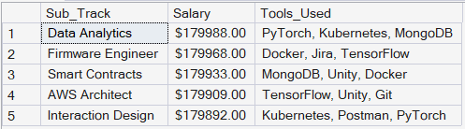
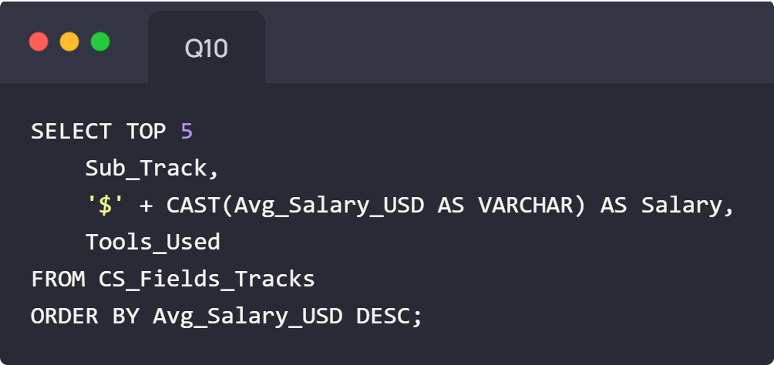
Q10: ACTIONABLE SKILLS (HIGHEST PAID TOOLS)
Which tools are used in the TOP 5 highest-paying individual records?
To give direct, actionable guidance on which high-value skills/tools to acquire immediately.

Slide 18
CONCLUSION
- This project demonstrates how structured data analysis can turn scattered information into actionable insights that guide real-world career decisions.
- By grouping the 20 analytical questions into a three-part narrative — Market Overview, Financial Insights, and Career Strategy — the story becomes clear:
💡 Where the opportunities are.
💡 What pays the most.
💡 Which paths offer the strongest future potential.
The data shows that the tech landscape is full of high-growth, high-reward specializations, and with the right track, the roadmap to success becomes measurable and achievable.

Slide 19
THANK YOU
FOR YOUR ATTENTION AND ENGAGEMENT.
Data doesn’t just tell a story — it guides the future.
Special thanks to Eng. Dina Mohsen
Project created by: Amr Khaled
NTI Data Analysis

